Slide 1
Automating Pen and Ink Landscape Renderings
Jim Mower
Geography and Planning
University at Albany
NYSGIS State Agency Advisory Group Meeting
Summer 2006

Slide 2
Classic Block Diagrams
Block diagrams represent
  Landscape views in perspective
  Underlying bedrock geology
They employ
  Large scale views
  Pen and ink renderings

Slide 3
Armin Lobeck
Lobeck wrote a wonderful book on block diagrams and other perspective landscape illustrations
  Lobeck, A.K (1958) “Block diagrams and other graphic methods used in geology and geography.” Emerson-Trussell Book Co., Amherst, MA.
It contains drawing instructions and many examples

Slide 4
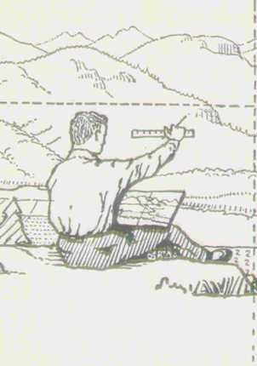
Purpose of My Project
Automate pen & ink
rendering techniques
Generate views from
DEMs using expert
systems approach
Several interesting
problems arise…

Slide 5
Easy Problems to Solve
Geometry
  Using Direct3D, render surface using only “ridge lines” and hachures
  Hachures are implemented as the line of steepest descent through a triangular surface facet
  Ridges are implemented as boundary lines between visible and invisible facets relative to the viewpoint

Slide 6
Rendered Lines
Viewpoint
Rendered
Ridge
Ridge
Line of sight
Visible facets
Invisible facets
Rendered
hachure
Line of steepest
descent
Hachure
Facet
Plane of ellipsoid

Slide 7
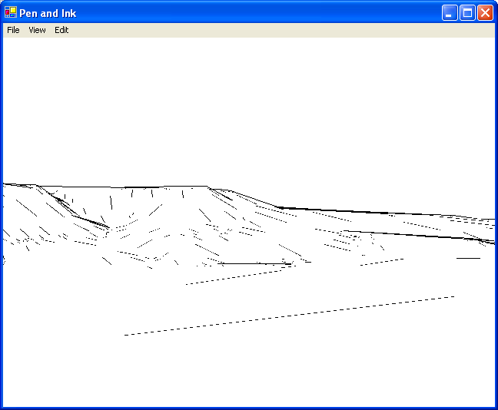
Easy Problems Solved! But…
Good ridge
Bad ridge
Good hachure
Bad hachure

Slide 8
How Do You Eliminate Crud?
Controlling hachure and ridge density automatically
  A generalization problem
  At a given rendered thickness, hachures should never touch one another
  Both ridges and hachures should not be drawn for purely geometric reasons
  Must define significance for both types of renderings

Slide 9
Defining Significance
Slope criteria
  Only show a ridge line if the angle of the intersecting facets is greater than a minimum value
  Only draw a hachure if its plane exceeds a minimum slope and is beyond a minimum distance from the VP

Slide 10
Other Significance Criteria
Only show a ridge line if it coincides with a hydrological ridge
  A drainage basin boundary
  Might be too restrictive
    Escarpments are not necessarily drainage basin boundaries
Detect 2D line proximity after rendering
  Create buffers around hachures, check for intersection, delete lowest slope

Slide 11
Significance Criteria (cont.)
Adaptive surface resampling
  The input DEM is a TIN with variable resampling with distance from the VP
  Resampling is currently performed from a densely sampled DEM in a separate program
  Could perform resampling on the fly in this program

Slide 12
Lots of Things To Do
But that’s the fun part!
Questions?

